Slide 1


AI Application System
(ISE4132)
Week _ Lecture
ISE Department Prof. Mehdi Pirahandeh
School of Global Convergence Studies

Slide 2

Combining Policy Gradient and Q-Learning (Part I)
1
School of Global Convergence Studies

Slide 3
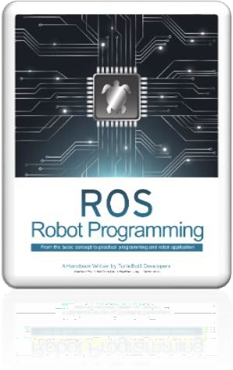
Contents
Deep Deterministic Policy Gradient (DDPG)
Twin Delayed DDPG (TD3)
School of Global Convergence Studies

Slide 4
Deep Deterministic Policy Gradient (DDPG)

Slide 5
Deep Deterministic Policy Gradient (DDPG)
Deep Q-Networks (DQN) vs DDPG
DQN can only handle discrete and low-dimensional action space while solving high-dimensional state space
DDPG:
Model free
Off-policy
Continuous and high dimensional space
Actor-Critic
Replay-Buffer
Target Network
School of Global Convergence Studies
Notes:
While DQN solves high dimensional state space, it can only handle discrete and low-dimensional action space. DQN cannot be applied to continuous and high-dimensional action domains. (e.g. control tasks like robots)
DDPG is an algorithm that is as follows:
Model Free: we don’t know the model. We learn it from interaction of the agent with the environment
Off-Policy: DDPG, like DQN, used as exploratory policy to generate transitions and learns a deterministic policy
Continuous and high-dimensional action space: DDPG works only for a continuous action domain and works well with high-dimensional action spaces
Actor-Critic: this means we have an actor (policy network) and critic, the action-critic-value (q-value) network
Replay-Buffer: like DQN, DDPG uses a replay buffer to store translations and uses them to learn. This breaks the temporal dependence/correlation of training examples, which could otherwise mess up the learning
Target Network: like DQN, it uses a target network to provide fairly stable targets for the q-values to learn. However, unlike DQN, it does not update the target network by copying over the weights of online/agent/main network periodically. Rather, it uses the polyak/exponentional average to keep moving the target network a little bit after every update to the main network

Slide 6
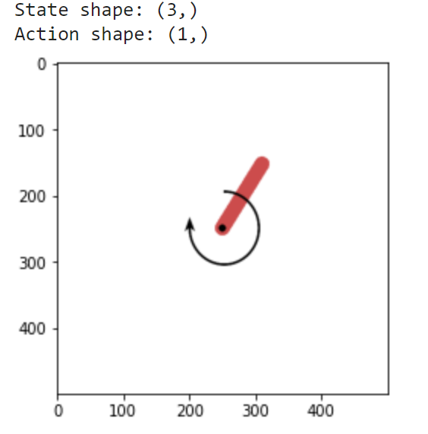
Deep Deterministic Policy Gradient (DDPG)
Environment – |Pendulum-v1|
School of Global Convergence Studies

Slide 7
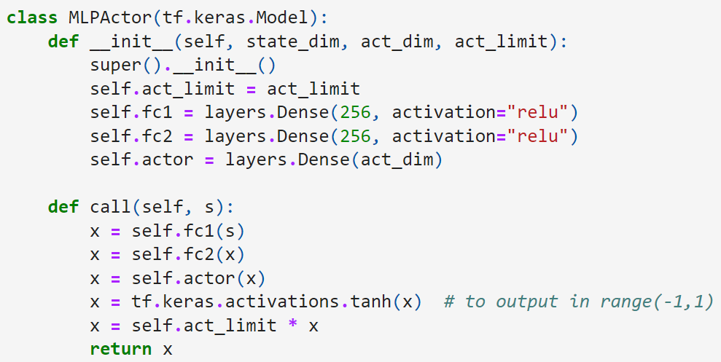
Deep Deterministic Policy Gradient (DDPG)
Actor Network
School of Global Convergence Studies
Notes:
Lets turn our attention to actual coding part. First look at actor network. We define a simple neural network with two hidden layers of size 256, each with ReLU activation. We implement the network forward logic in a function called ‘call’. If you look at ‘call’ function, you will notice that the final layer (self.actor) is passed through the ‘tanh’ activation. It re-maps the values in ($−∞;∞$) to a squashed range (-1, 1). We then multiply this squashed value with the action limit (self.action_limit) so that the continuous output from ‘MLPActor’ is within the valid range of action values that the environment accepts.

Slide 8
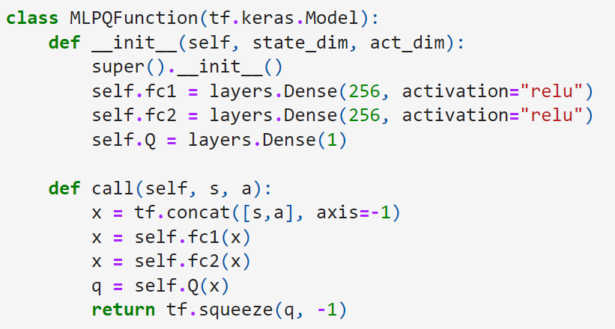
Deep Deterministic Policy Gradient (DDPG)
Q-Network Critic
School of Global Convergence Studies
Notes:
Q-Network (Critic)
This is also a simple two-layer hidden network with ReLU activation and then a final layer with number of outputs equal to one. The final layer does not have any activation, enabling the network to produce any value as output of the network. This network is outputting the q-values, and that is why we need to have a possible range of ($−∞; ∞).$

Slide 9
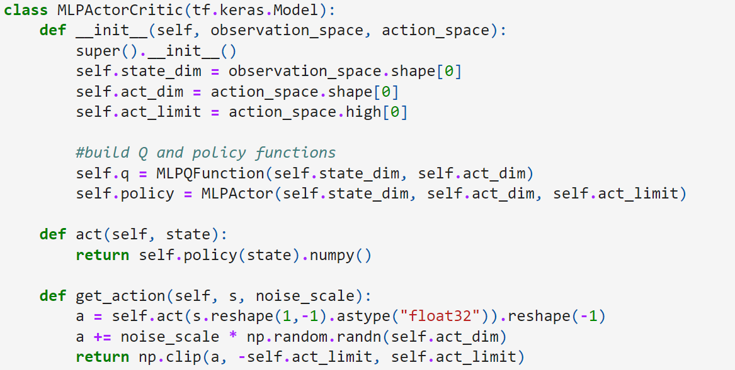
Deep Deterministic Policy Gradient (DDPG)
Combined Model Actor-Critic Implementation
School of Global Convergence Studies
Notes:
One both networks are defined, we combine them into a single class that allow us to manage the online and target networks in a more modular way. This is just for better code organization and nothing more. The class combining the two networks is implemented as ‘MLPActorCritic’. In this class, we also define a function ‘get_action’, which takes the state and a noise scale.

Slide 10
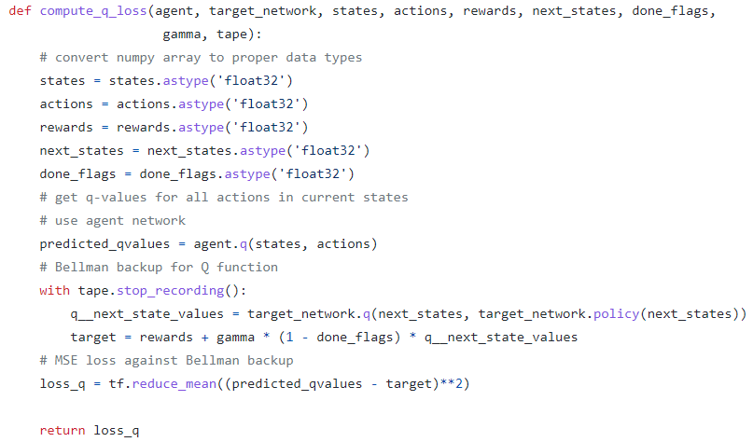
Deep Deterministic Policy Gradient (DDPG)
Q-Loss Implementation
School of Global Convergence Studies
Notes:
Next, we look in into the Q-Loss calculation.
After converting numpy array to proper data types, then we calculate Q-values (predicted_qvalues) using the batch of (states, actions) and pass it through the policy (target) network.
Following this, we calculate the target value and loss q_values by using ‘tape.stop_recording()’ to stop the gradient computation in the target network.

Slide 11
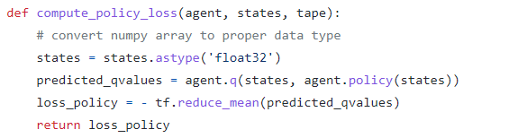
Deep Deterministic Policy Gradient (DDPG)
Policy Loss Implementation
School of Global Convergence Studies
Notes:
This is a straightforward computation. It is just a three-line code implementation. Please note the ‘-’ sing in the loss. Our algorithm needs to do gradient ascent on the policy objective, but auto-differentiation libraries like Tensorflow implement gradient descent. Multiplying the policy objective by -1.0 makes it a loss, and gradient descent on a loss is the same as gradient ascent on a policy objective.

Slide 12
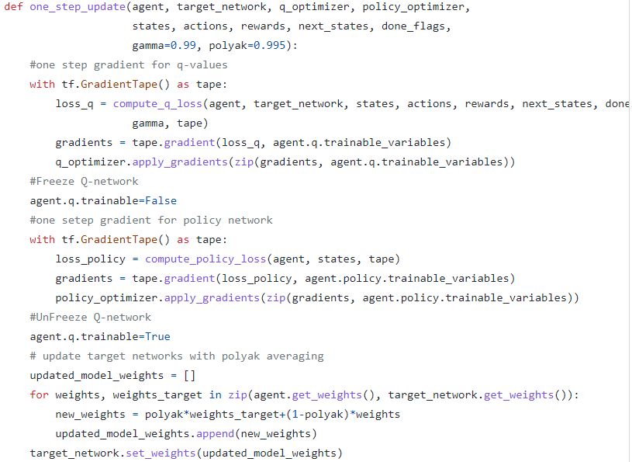
Deep Deterministic Policy Gradient (DDPG)
One Step Update Implementation
School of Global Convergence Studies
Notes:
Next, we define a function called ‘one_step_update( )’ that gets a batch of (states, actions, rewards, next_states, done_flags) and compute the Q-loss followed by back propagation and then a similar step of policy-loss computation followed by the gradient step. It finally carries out an update to the target enetwork weights using ‘polyak’ averaging.

Slide 13
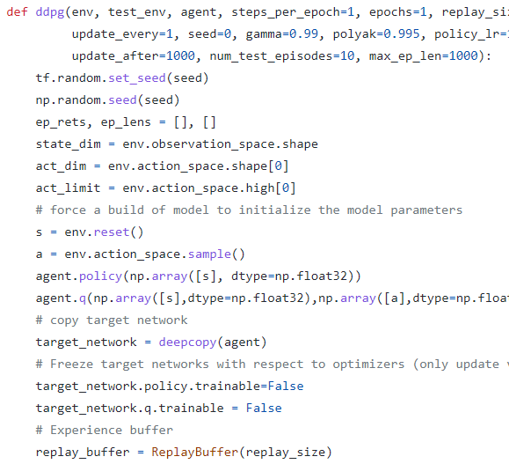
Deep Deterministic Policy Gradient (DDPG)
DDPG Main Loop
School of Global Convergence Studies
Notes:
The final step is the implementation of the DDPG algorithm, which uses the earlier ‘one_step_update’ function. It creates the optimizer and initializes the environment. It keeps stepping through the environment using the current online policy.
We run the code multiple times in the loop. We have used ‘epochs=5’ for demonstration purposes. You may want to run it a lot longer, something like 100 epochs or so.

Slide 14
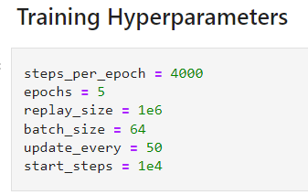
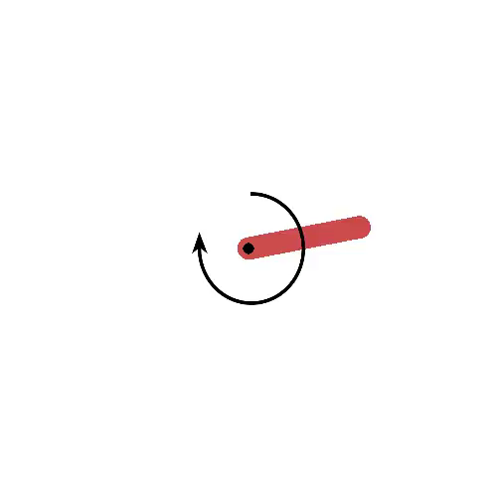
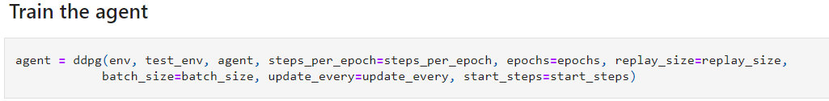
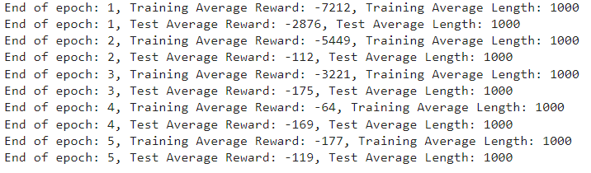
Deep Deterministic Policy Gradient (DDPG)
School of Global Convergence Studies
Notes:
The final step is the implementation of the DDPG algorithm, which uses the earlier ‘one_step_update’ function. It creates the optimizer and initializes the environment. It keeps stepping through the environment using the current online policy.
We run the code multiple times in the loop. We have used ‘epochs=5’ for demonstration purposes. You may want to run it a lot longer, something like 100 epochs or so.

Slide 15
II. Twin Delayed DDPG (TD3)

Slide 16
Twin Delayed DDPG (TD3)
Twin Delayed DDPG vs DDPG
DDPG suffers from the overestimation bias
Twin Delayed DDPG (TD3)
Clipped double Q-Learning
Delayed policy updates
Target policy smoothing
School of Global Convergence Studies
Notes:
Clipped double Q-Learning: Twin Delayed DDPG (TD3) uses two independent Q-functions and takes the minimum of the two while forming targets. This modification is the reason the algorithm is called ‘twin’
Delayed policy updates: TD3 updates the policy and target networks less frequently as compared to the Q-function updates. It is recommended that one update to the policy and target networks for every two updates of the Q-function. This modification is the reason to call this algorithm ‘delayed’
Target policy smoothing: TD3 adds noise to the target action, making it harder for the policy to exploit Q-function estimation errors and control the overestimation bias

Slide 17
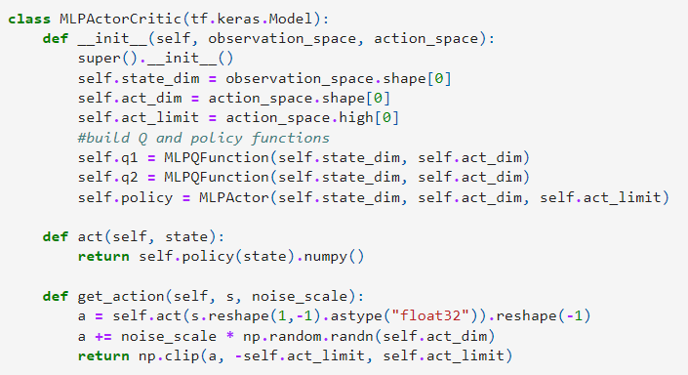
Twin Delayed DDPG (TD3)
Combined Model Actor-Critic Implementation
School of Global Convergence Studies
Notes:
The individual Q-network (critic) MLPQFunction and policy-network (actor) MLPActor are the same as we saw for DDPG. However, the agent where we combine the actor and critic together MLPActorCritic has a minor change. We now have two Q-networks in line with the ‘twin; part of TD3.

Slide 18
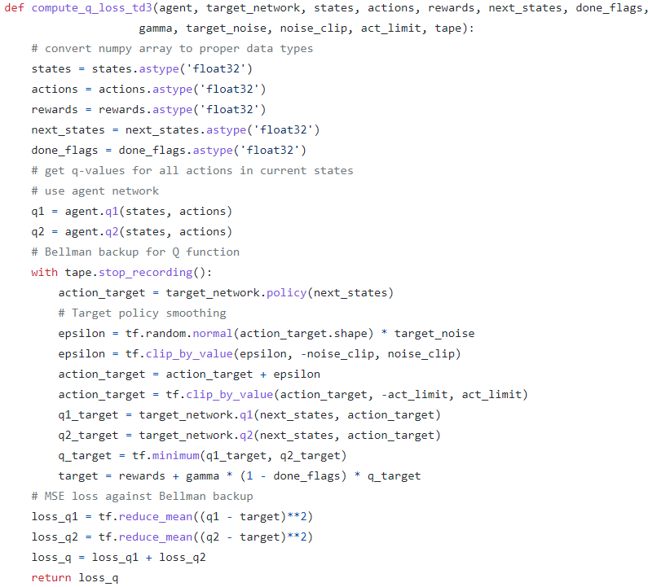
Twin Delayed DDPG (TD3)
Q-loss Implementation
School of Global Convergence Studies
Notes:
The next change is in the way Q-loss is calculated. We implement target policy smoothing and clipped double Q-learning

Slide 19
Twin Delayed DDPG (TD3)
TD3 Main Loop
School of Global Convergence Studies
Notes:
There are some changes in the main loop of TD3 compared to DDPG’s one. Unlike DDPG, in TD3 we update the online policy and the target weights once for every two updates of Q-networks. It is a minor change to the DDPG’s main loop code.

Slide 20
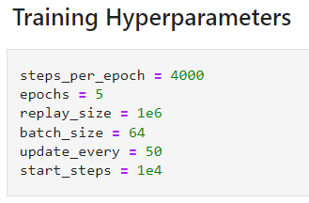
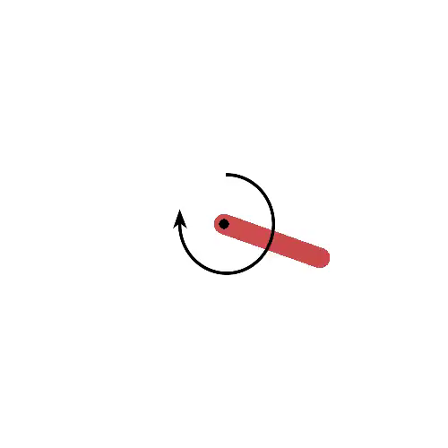
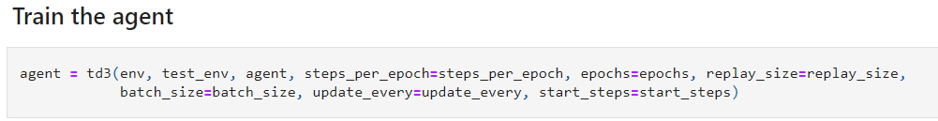
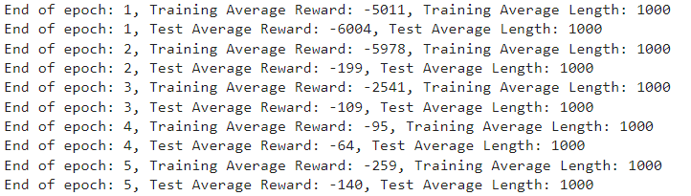
Twin Delayed DDPG (TD3)
School of Global Convergence Studies
Notes:
We run TD3 for the Pendulum environment. We can see that after five episodes, the pendulum gets well balances in the upright condition.

